Slide 1
GE Transportation/Wabtec iSupplier Portal (iSP) Training

Slide 2
Overview
GE Transportation/Wabtec provides our suppliers an excellent resource to easily submit invoices and check invoice and payment status through the GETS iSupplier Portal (iSP)
PO
RECEIPT
INVOICE
PAYMENT

Slide 3
Getting registered to use iSP
Please request iSP registration by sending an email to eBusiness.helpdesk@Wabtec.com with the following required information:
First and last name
Email address
Phone number
Your GE Transportation supplier code OR a recently issued GETS purchase order number

Slide 4
Getting registered to use iSP
Please note, that on the 5th of every month a notice is sent out to ALL users that have NOT signed in to ISP in 365 days. If you receive this notice, you will have 10 days to log into your account or your account will be deactivated.

Slide 5
Getting registered to use iSP
Please send a request to the: GETWabtec_Supplier_Onboarding@wabtec.com We will reply with a user name and password for you. You will receive a password reset the first time you log in. Sometime later in Aug or early Sept the logins will be changed, to a tool called OKTA, this is the Wabtec authentication system. Notification will be sent in advance of this change, and you will have 7 days to activate your new access, once our ERP has been moved into the Wabtec Data center.
Please send your request to:
GETWabtec_Supplier_Onboarding@wabtec.com We will reply with a user name and password for you. You will receive a password reset the first time you log in.
Later in Aug or early Sept the logins will change:
New Tool OKTA
Wabtec authentication system. Notification will be sent in advance of this change, and you will have 7 days to activate your new access, once our ERP has been moved into the Wabtec Data center.

Slide 6
GETS POs eligible for web invoicing
INELIGIBLE:
Credit Card: POs containing credit card information in the BILL-TO section (please invoice by processing these credit card details with your payment processor)
Repeat Pay: POs containing repeat payment instructions (please note the repeat payment dates or process the credit card details attached to the PO copy on the dates prescribed.
Evaluated Receipt Settlement (ERS): POs set up for ERS issue invoices automatically as parts are received or services are marked rendered by the requestor on the PO copy. If you are a direct materials supplier and have questions about whether or not you are setup for ERS, please contact eBusiness.helpdesk@Wabtec.com
ELIGIBLE:
Web Invoicing: POs that explicitly state that web invoicing is required in the BILL TO section on the PO hard copy

Slide 7
Creating invoices on ISP
Begin by logging in @
WWW.Wabtec.com/iSupplier.com

Slide 8
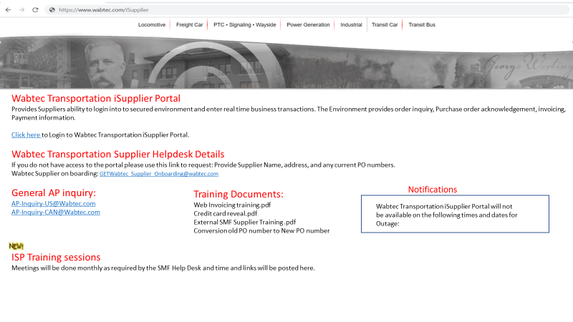
Creating invoices on ISP
CLICK ENTER SITE
AND SIGN IN

Slide 9
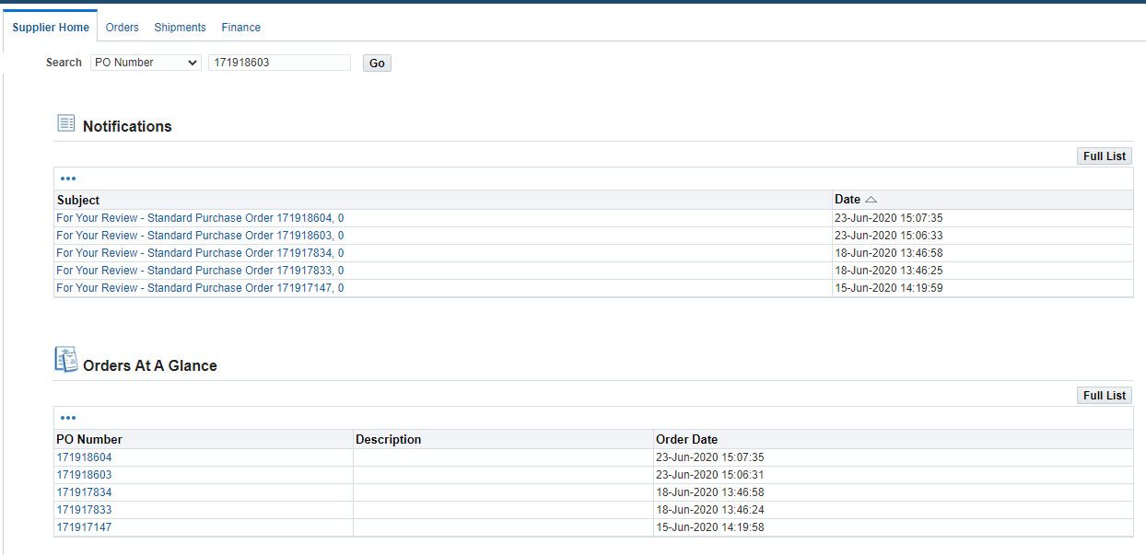
iSupplier Home Screen
In iSupplier Home Screen you will find four tabs – Supplier Home / Orders / Shipments / Finance
Notifications
This will show most recent POs with Wabtec
Supplier Home – iSupplier home screen were you will see Notifications related to recent POs.
Orders – will help you query POs using Order Number, or request for cancellation
Shipments – will give you shipment information by using order or receipt number
Finance – Supplier will be able to create invoice and query for invoices/payments

Slide 10
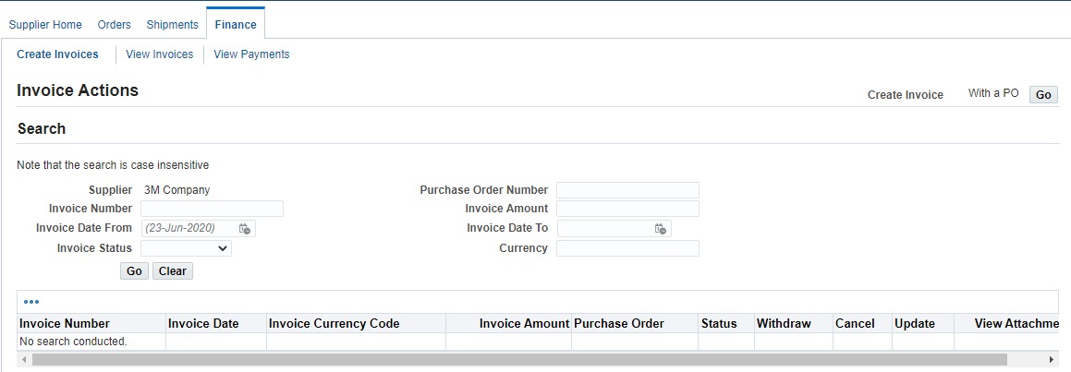
iSupplier AutoInvoicing
In iSupplier Home – Click on Finance Tab. You will get the following screen.
At the right corner of the screen, you will see “Create Invoice With a PO” – Click the Go button

Slide 11
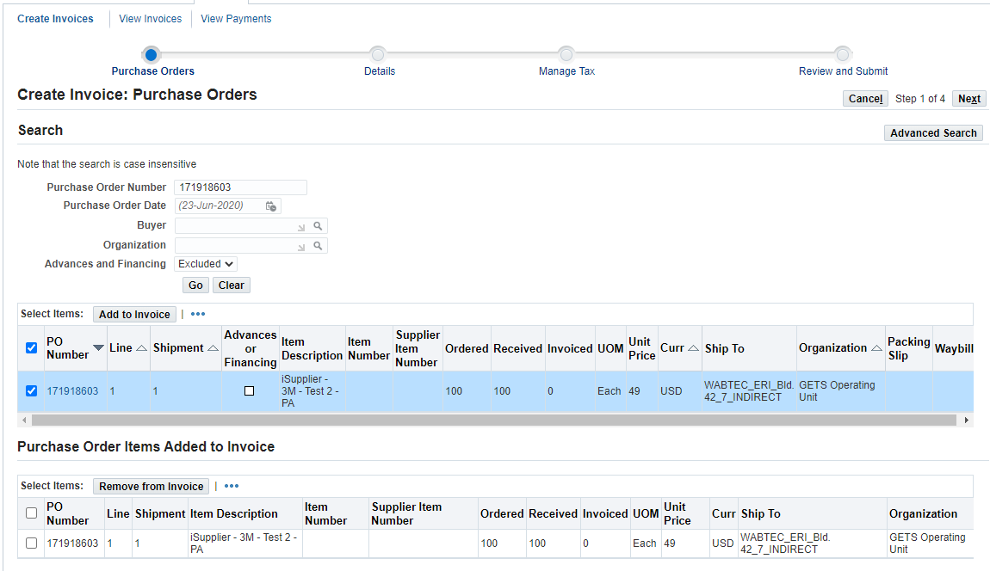
iSupplier AutoInvoice – Step 1 – Purchase Orders
In the PO number field, capture the PO for which you will be creating the invoice. Then click the “Go” Button
You will get the PO Lines that are available to be invoiced, select the invoice line and Click “Add to Invoice” Button
Once you get the Items Added to Invoice screen and verify the needed PO lines are included, click “Next”.

Slide 12
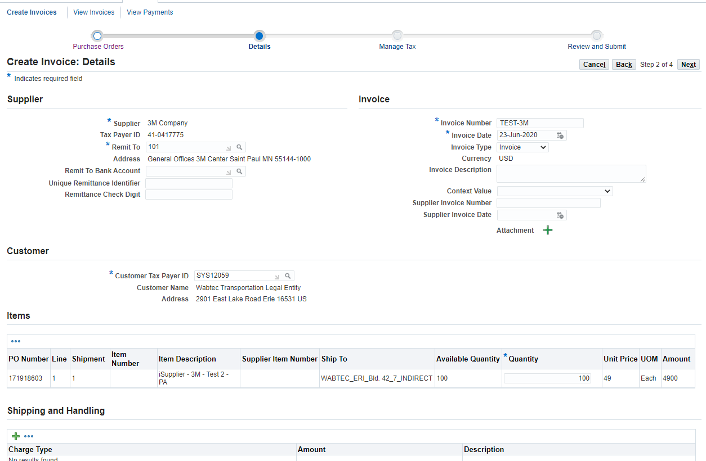
iSupplier AutoInvoice – Step 2 – Details
Go to Invoice Details on the right side of the screen and capture the Invoice Number and Invoice Date fields.
Invoice terms will start based out of Invoice Creation Date.
Feel free to include Invoice Description, Supplier Invoice Number and Supplier Invoice Date fields if needed.
Once you verified the details of the invoice, click “Next”.

Slide 13
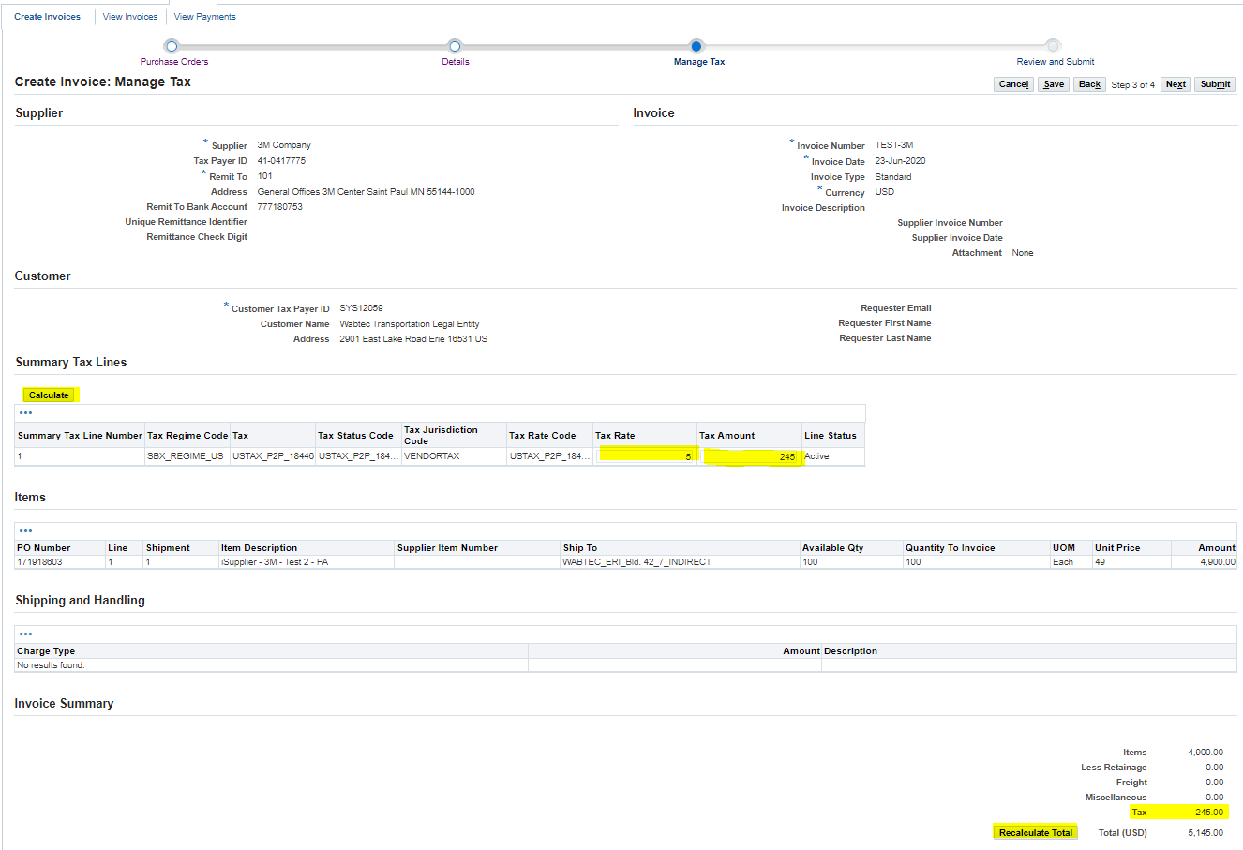
iSupplier AutoInvoice – Step 3 – Manage Tax
At Summary Tax Lines capture Tax Rate and Tax Amount fields, once done, click Calculate.
Review invoice Summary Totals, you will see that tax lines are not included, so click Recalculate Total button.
Tax Amount should be added after Recalculate button is clicked.
Click “Next” to move to the last Step for Invoicing

Slide 14
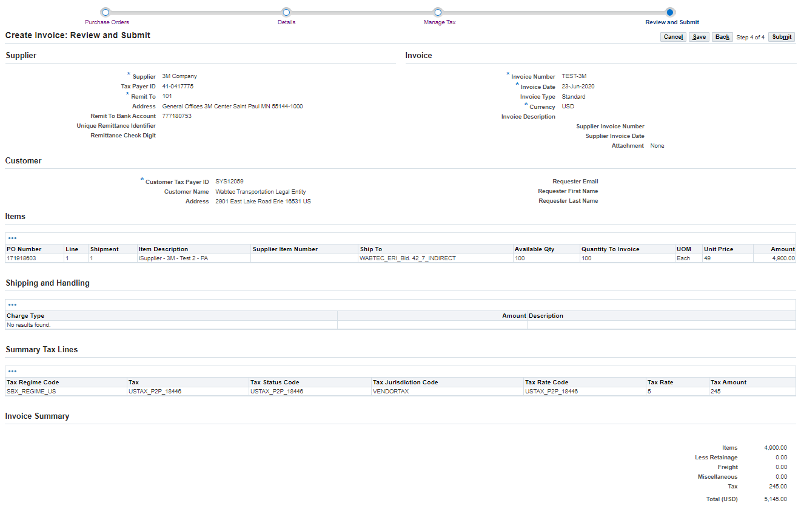
iSupplier AutoInvoice – Step 4 – Review and Submit
Review Invoice Line Details, if no changes are needed click “Submit”.
In case you need to perform a change in any of the previous steps, click “Back” button

Slide 15
iSupplier AutoInvoice – Confirmation
You will get a confirmation message that your invoice has been created successfully.
To see your invoice details, you can always go to Finance tab → View Invoices and query using Invoice Number.
This form will give you visibility about your invoice related to your:
Invoice Status
Invoice Holds
Invoice Payment Status

Slide 16
FAQ – Invoice/Payment
Why is my invoice on hold?
If your invoice is in HOLD status, please contact the requestor on the PO copy so they may work to resolve this hold.
Invoices pay per agreed-upon payment terms. You can check your payment date within the portal by referencing the discount date or due date.
When will my invoice pay?
What are my payment terms?
Why can’t I find my invoice in the portal?
I input my invoice number in the Supplier Collaboration Portal (SCP) but can’t find it on the iSupplier Portal.
Your terms may vary based on your contractual obligations with us. Please
note the terms listed on the hard copy of the purchase order and for further
clarification contact your GETS buyer.
Please note that it takes one business day for invoices to be searchable in iSP after submission. If you cannot find your invoice within the portal, please contact eBusiness.helpdesk@Wabtec.com so we may investigate.
Invoice numbers input from SCP by our direct material suppliers should be searched between two percentage signs, ex. “%123456A%” as this number is often contained within an ERS invoice number.

